Slide 1
Group 23
L4/L5
Kacey Evans
Andreea Mazarianu
Tomas Pribyl
Joseph Shuttlewood

Slide 2

Key point of the brief
Single player
Consider a genre that has a typical
mechanic defined as integral to it
Substitute the mechanic
Emphasis on a single mechanic

Slide 3


How does the game meet the brief?
Single player
Chosen genre: shooter
Defining mechanic: shooting
Substitute for the mechanic: trapping
Emphasis on a single mechanic: catching rats is possible only by trapping them

Slide 4
What is the game?
place trap
find bait
place bait on the trap
catch rats
First person
Player vs. environment (PVE)
Survival
Time Based
Puzzle

Slide 5

Aesthetics
Easy fun
Exploration
Creativity
Surprise
Hard fun
Fiero
Dramatic tension
Serious fun
Rhythm
Player skills tested
Mental (observational skills- finding bait)

Slide 6

https://www.youtube.com/watch?v=hAZUEgPwBEs

Slide 7
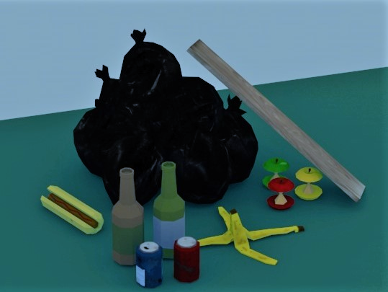
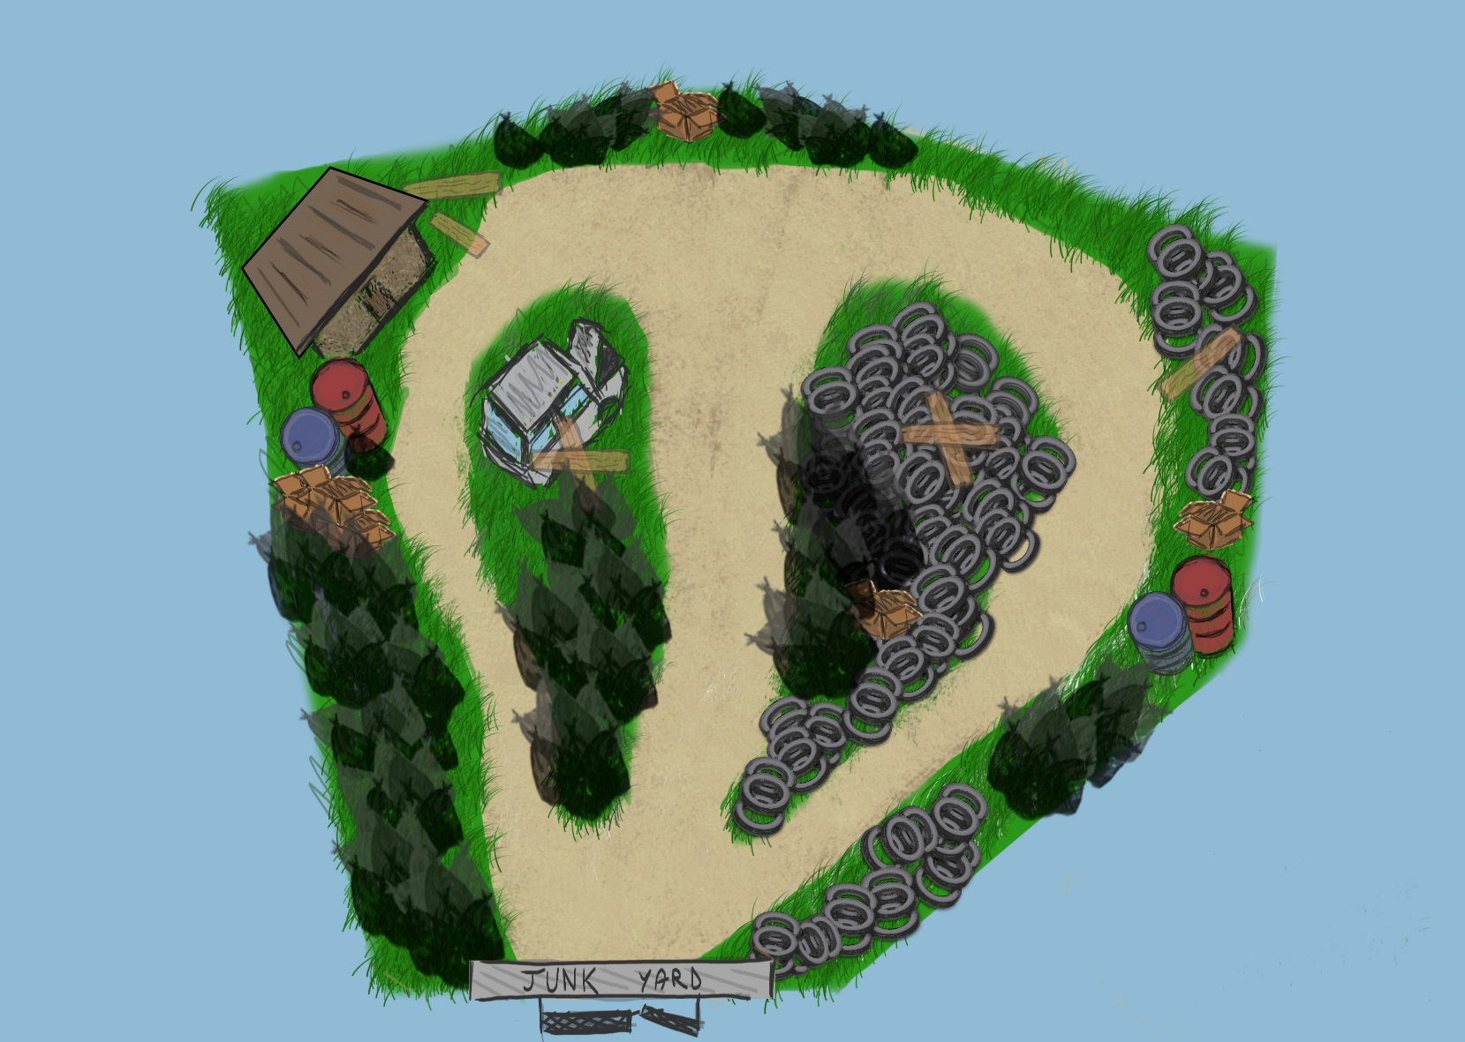
Our progress

Slide 8
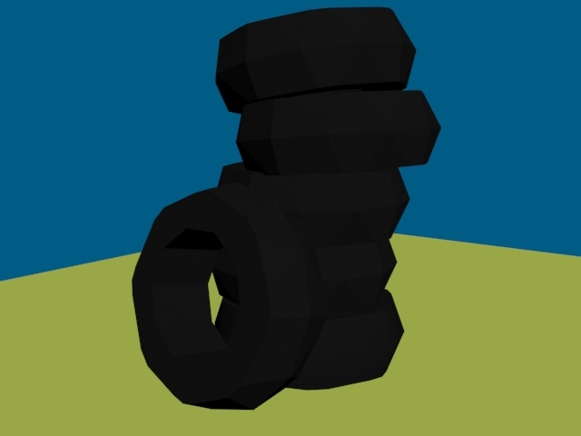

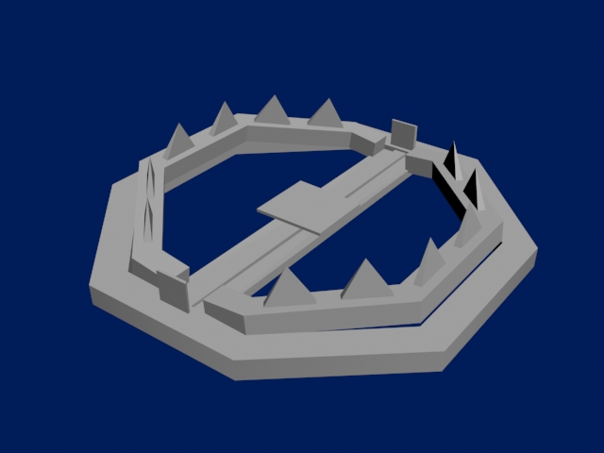
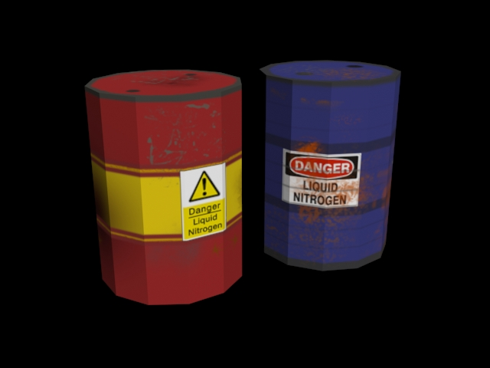


Slide 9

Questions?

